Slide 1


Million Song
Dataset Analysis
Jimmy Sisenglath
Eric Pham
Justin Eugenio

Slide 2

Overview
Introduction
Initial Operations
Primary Objective
Demo
Conclusion

Slide 3
1.
Introduction

Slide 4
Introduction
What is the motivation?
Is it possible to predict the genre based on audio features of songs?
Notes:
Explain why we did this topic for this project. We’ve wanted to see if we can predict the genre based on…

Slide 5
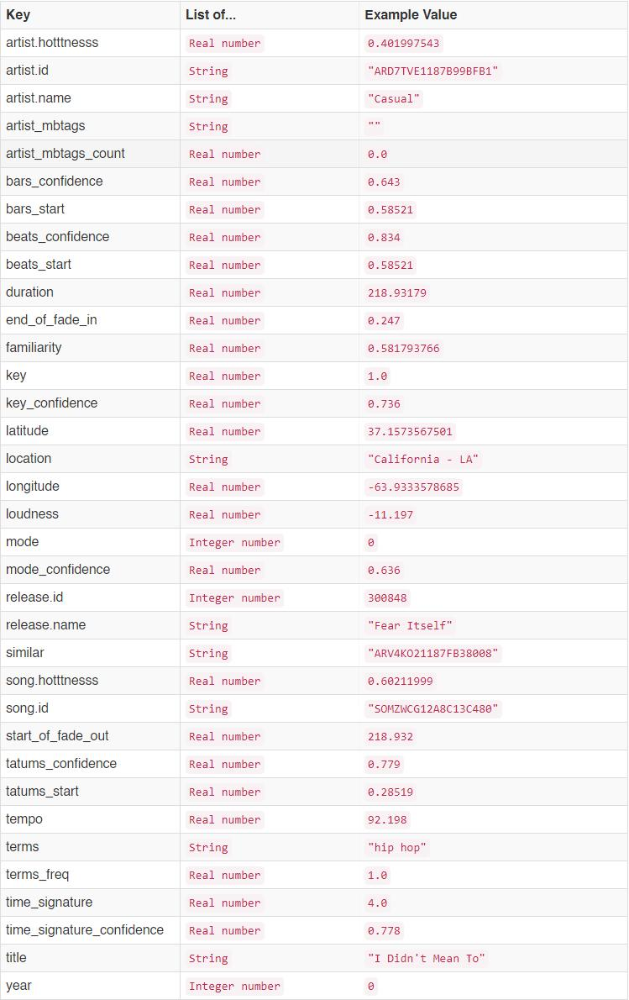
About Dataset
We have used the Million Song Dataset subset.
It contains audio features and metadata for
contemporary popular music tracks.
Original has 280 GB of data
Subset has 3.2 MB of data
More manageable to work with
10,000 songs & 35 attributes
5,155 dated tracks from 1922 to 2011
Notes:
Explain the attributes.

Slide 6
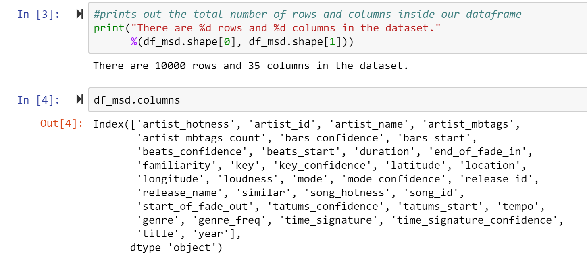
Exploring the Dataset
Dealing with 10,000 rows and 35 columns
Preview of what features we’re dealing with

Slide 7
2.
Initial Operations
Explore the data and find our objective.

Slide 8
Initial Operations
Before data cleaning, we wanted to explore our dataset named “df_msd.csv”.
Our result came out with 10,000 rows and 35 columns.
We listed our data in terms of years and took the mean of values in each column.
The only significant observation we had in that data frame is that as time went on, the average song duration increased.

Slide 9
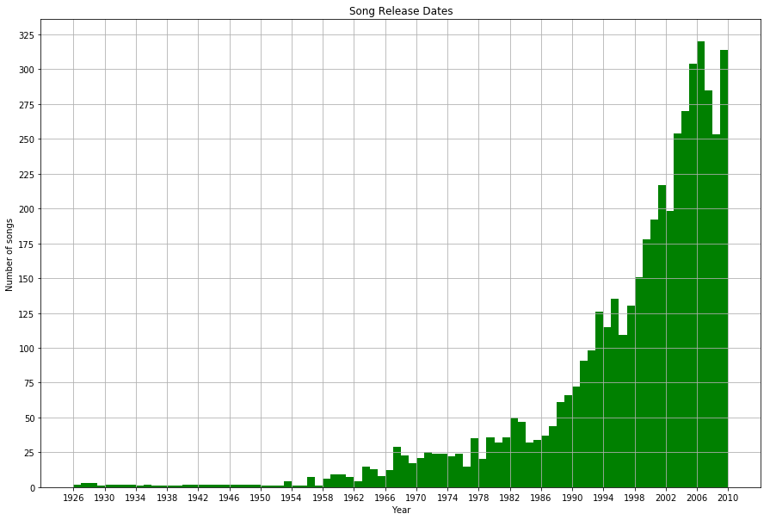
Histogram Showing Song Release Trend By Years
1926 to 2010. As years progress, more songs are being released.

Slide 10
Genres Found
0 hip hop
1 blue-eyed soul
2 salsa
3 pop rock
4 pop punk
5 southern gospel
6 breakbeat
7 post-hardcore
8 new wave
9 breakcore
10 alternative rock
11 ccm
12 bachata
13 chanson
14 quiet storm
15 country rock
16 chill-out
17 qawwali
18 hard rock
19 indietronica
20 classic country
21 electric blues
22 uk garage
23 math-core
24 pop rock
25 post-grunge
26 breakcore
27 filk
28 latin jazz
29 jump blues
...
9970 indie rock
9971 progressive house
9972 blues
9973 punk
9974 dance pop
9975 latin jazz
9976 post-hardcore
9977 shoegaze
9978 experimental pop
9979 country gospel
9980 afrobeat
9981 pop punk
9982 lullaby
9983 female vocalist
9984 alternative
9985 ccm
9986 dubstep
9987 dance pop
9988 doom metal
9989 post-hardcore
9990 no wave
9991 celtic
9992 irish
9993 bluegrass
9994 texas blues
9995 sympho black metal
9996 ballad
9997 lovers rock
9998 zydeco
9999 christian rock
Name: genre, Length: 10000, dtype: object
More than 10,000 genres were found.

Slide 11
3.
Primary Objective
Start cleaning and analyze the genre feature.

Slide 12
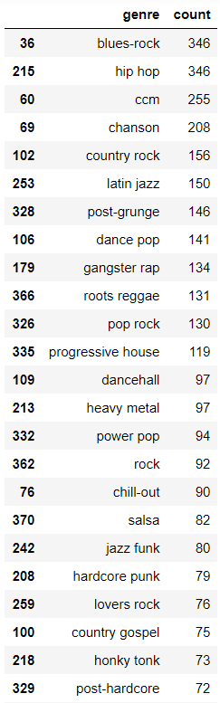
Finding Out The Top Genres
The primary objective of this project is to predict genres of songs. We decided to observe our genre feature. We created a dataframe called “top_genres” and examined what were the top ones.
Our top genres include “blues-rock”, “hip hop”, and “ccm” in the as our top 3 genres at 346, 346, and 255 counts respectively.
Notes:
CTRL+SHIFT+L to fix align issue.

Slide 13
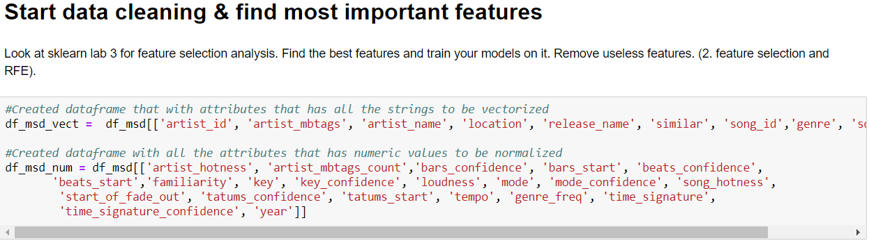
Preparations
To begin preparing our data, we created two datasets called “df_msd_vect” and “df_msd_num”
Notes:
Vectors for strings, normalization for numerics.

Slide 14
Begin To Normalize and Vectorize
Used one-hot-encoding for categorical features & standard scalar for numeric columns
Begin to normalize before sending to models
Merge both normalized dataframe and vectorized dataframe to start data clean

Slide 15
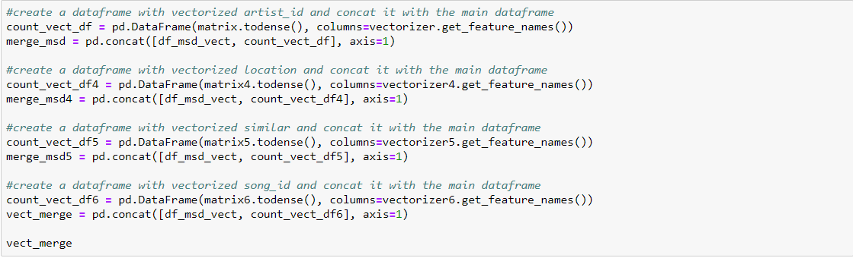
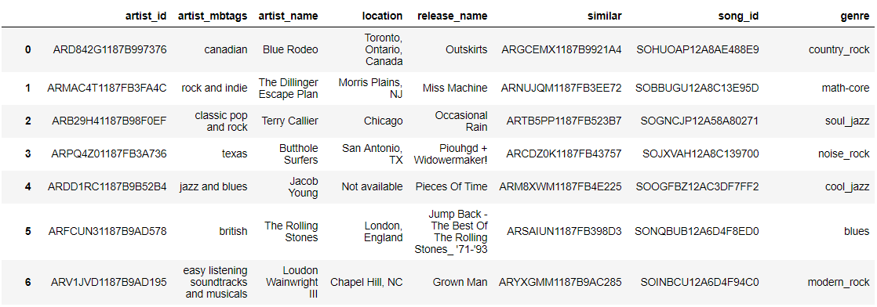

Vectorize

Slide 16
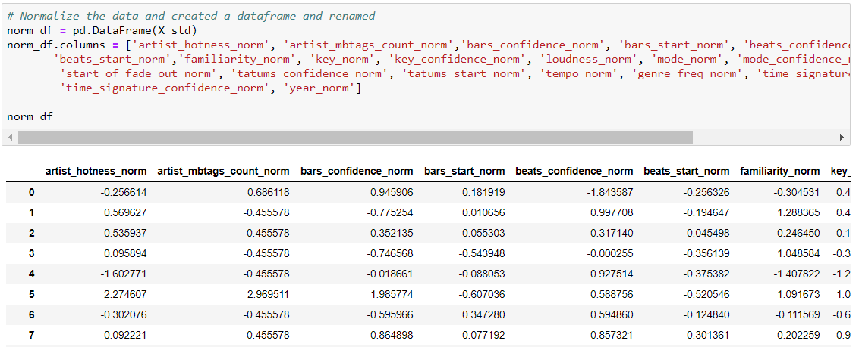
Normalization

Slide 17
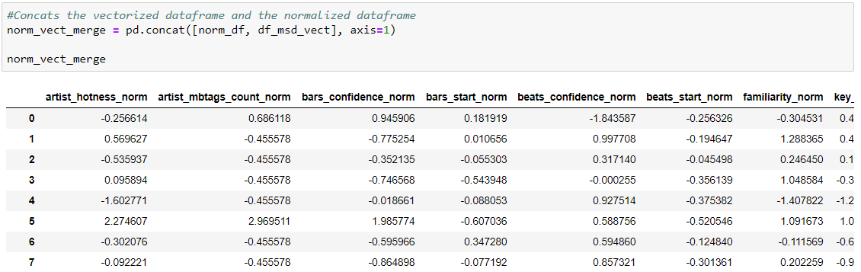

Concat to start data cleaning

Slide 18
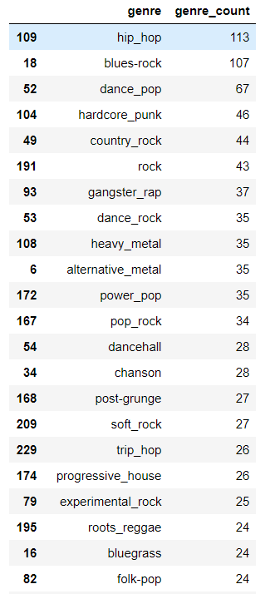
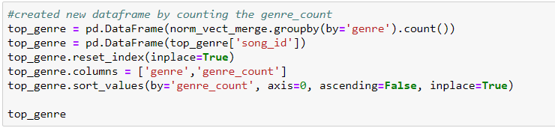

Filtering Genres
After data cleaning, we filtered out the genres that appeared more than 10 times in the “norm_vect_merge” dataframe
69 genres left in the top

Slide 19
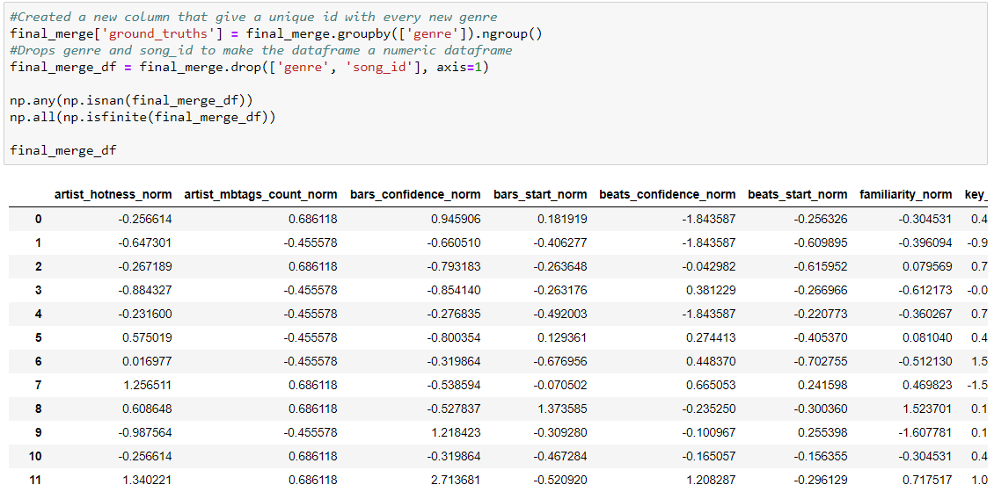
Final Dataframe
This is the final dataframe where we will be training, testing and splitting.

Slide 20
4.
Results
Normalizing, train & test, model performance results

Slide 21
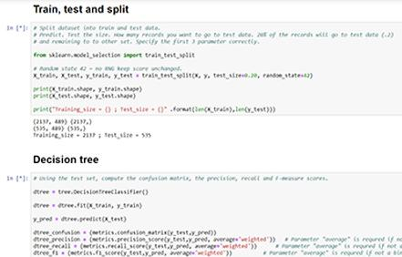
Demo
Jupyter Notebook in-depth.

Slide 22
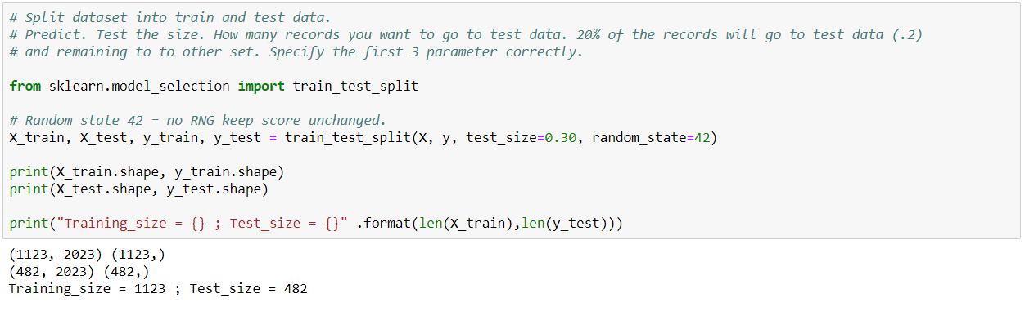
Training, Testing, and Splitting
Used 70% of data to train, 30% to test

Slide 23
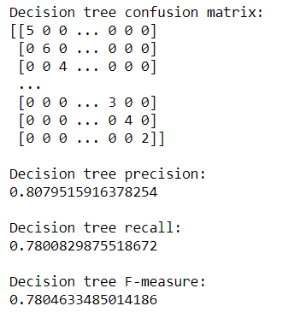
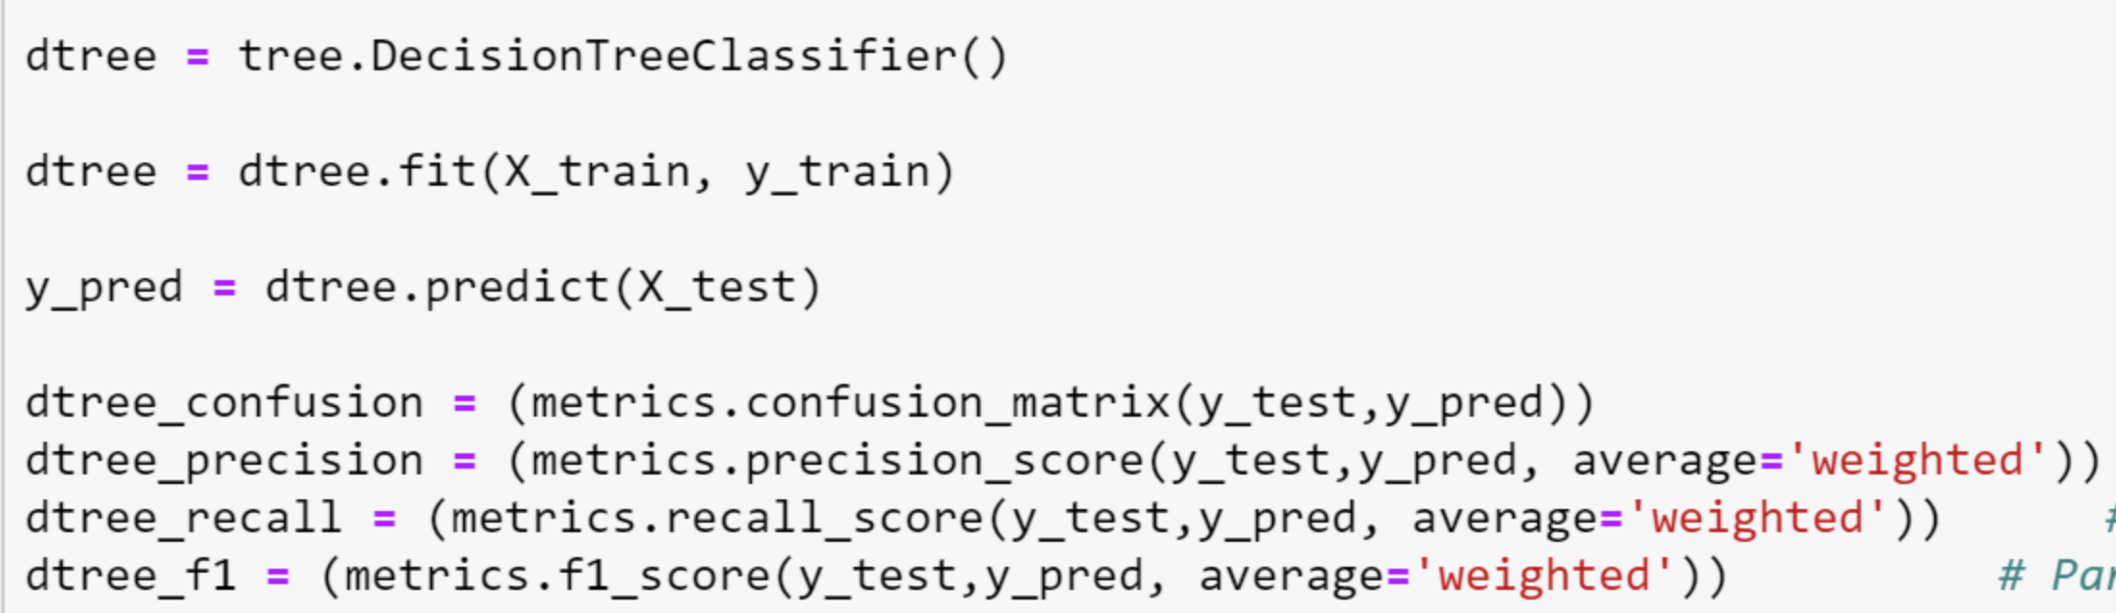
Decision Tree

Slide 24
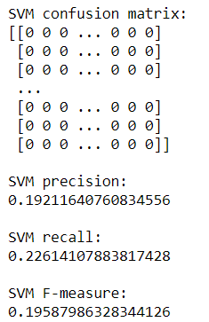
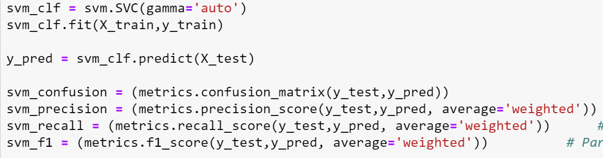
SVM (Support Vector Machine)

Slide 25
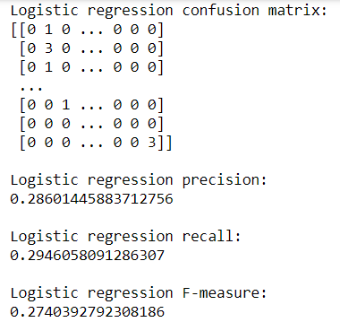
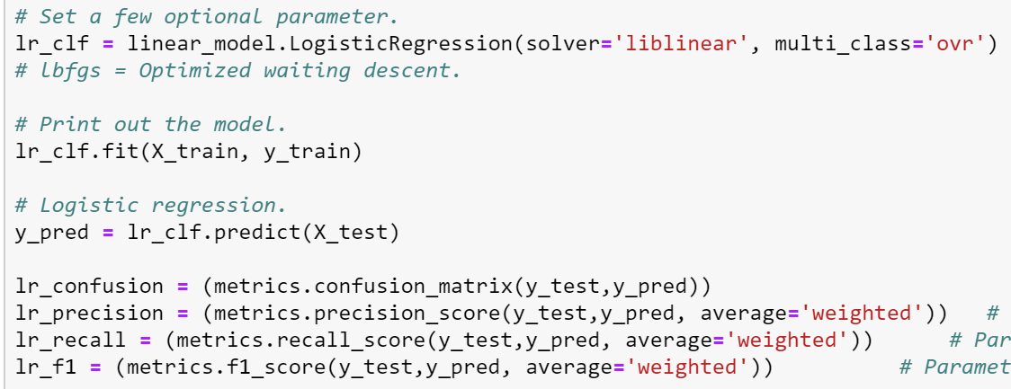
Logistic Regression

Slide 26
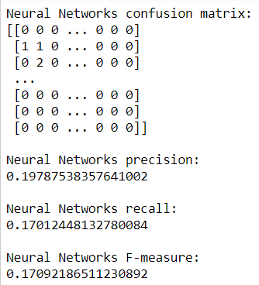
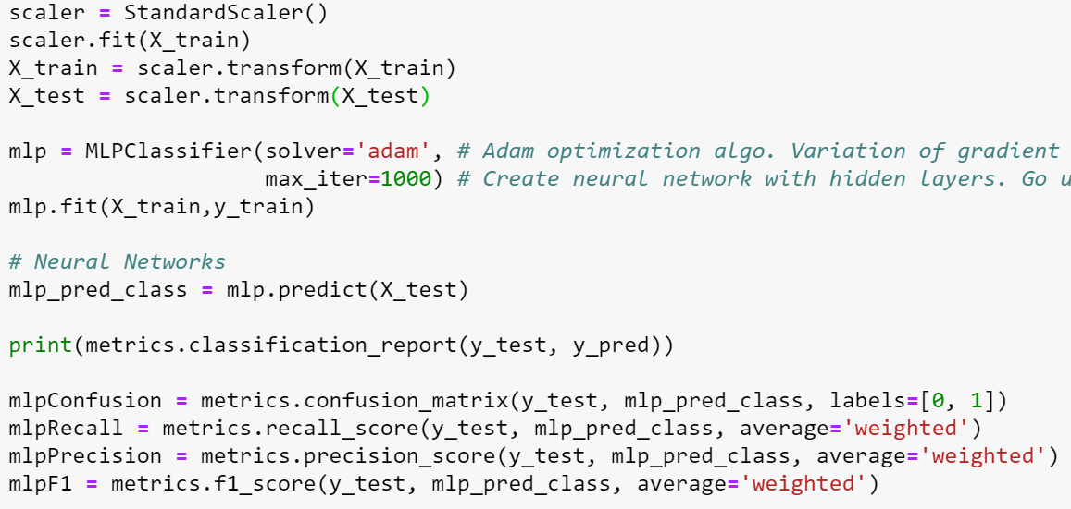
Neural Network

Slide 27
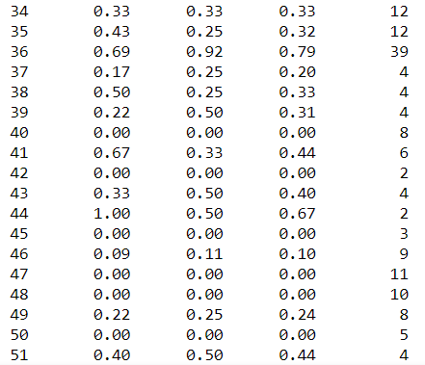
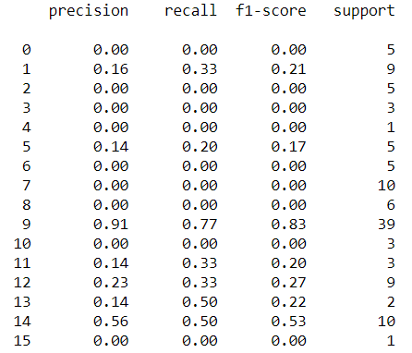
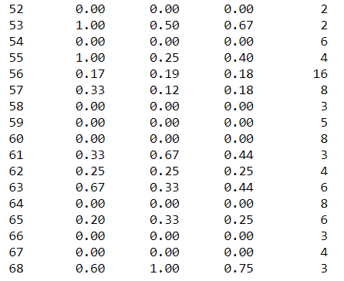
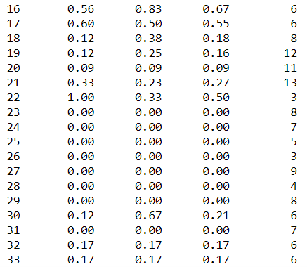

Neural Network

Slide 28
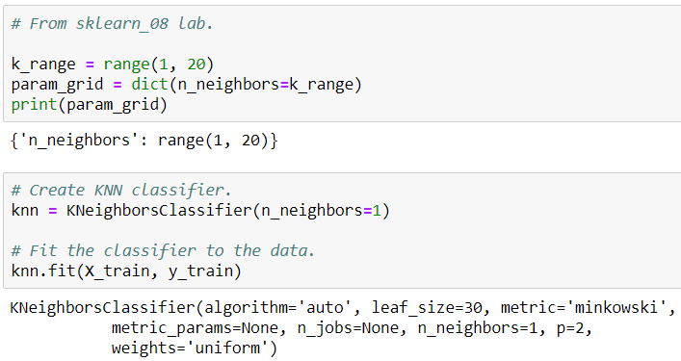
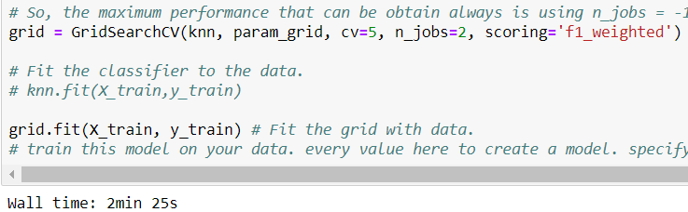
Train k-NN (k-Nearest Neighbors)

Slide 29
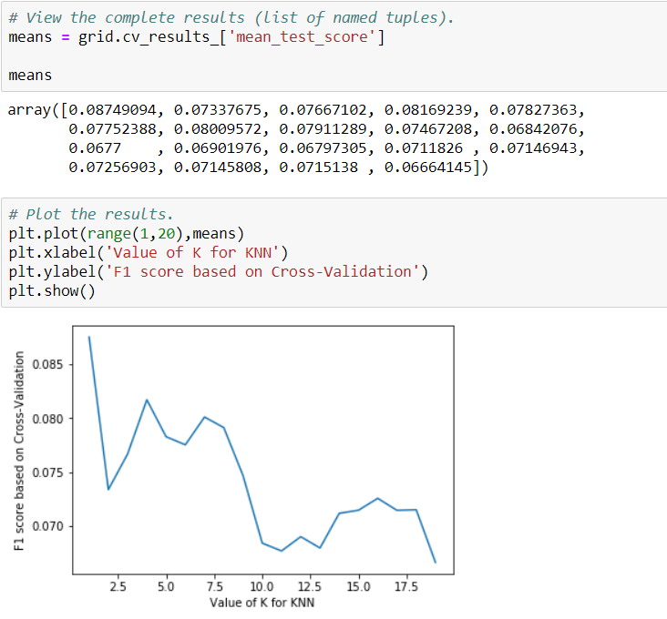
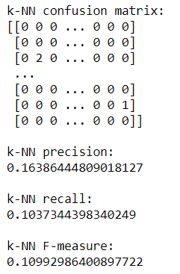
Train k-NN (k-Nearest Neighbors)

Slide 30
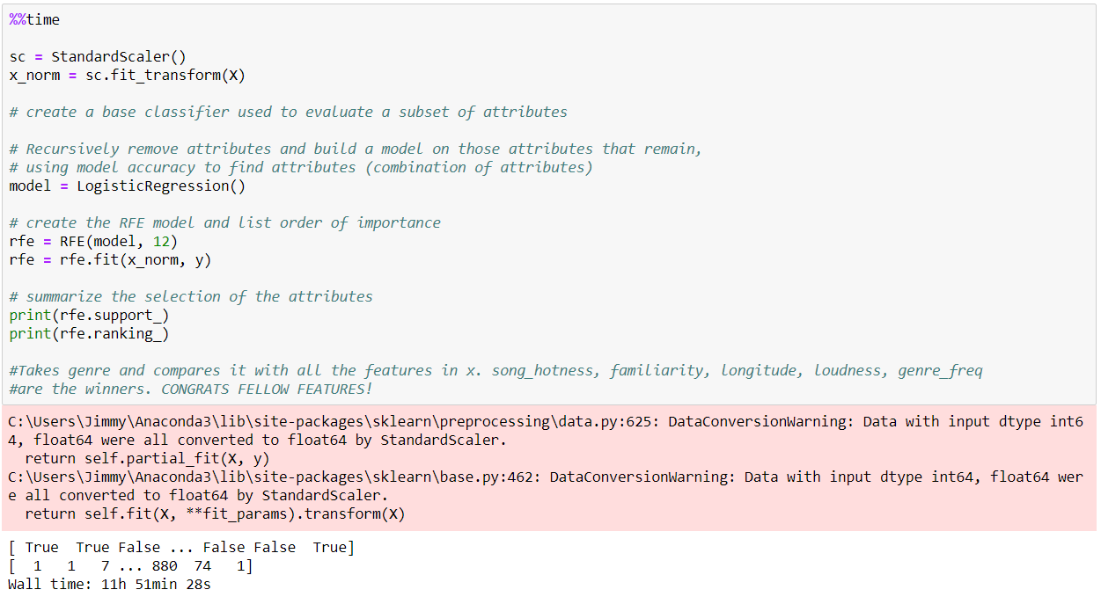
Recursive Feature Elimination (RFE)

Slide 31
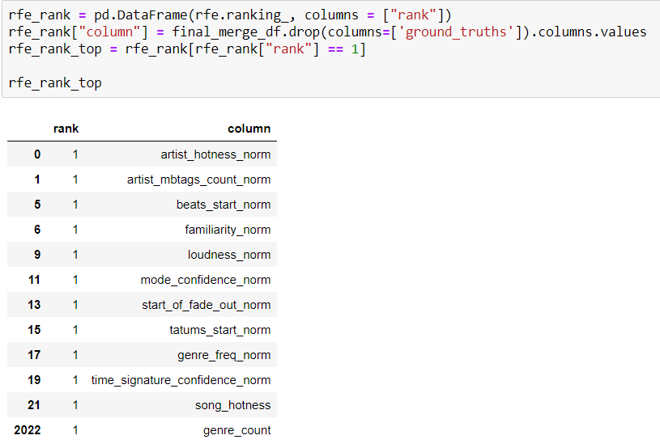
Recursive Feature Elimination (RFE)
Created a dataframe to intake all the values of rank from RFE and then outputting rank 1 to the dataframe
RFE returned:
Artist_hotness_norm, artist_mbtags_count_norm, beats_start_norm, familiarity_norm, loudness_norm, mode_confidence_norm, start_of_fade_out_norm, tatrums_start_norm, genre_freq_norm, time_signature_confidence_norm, song_hotness, genre_count

Slide 32

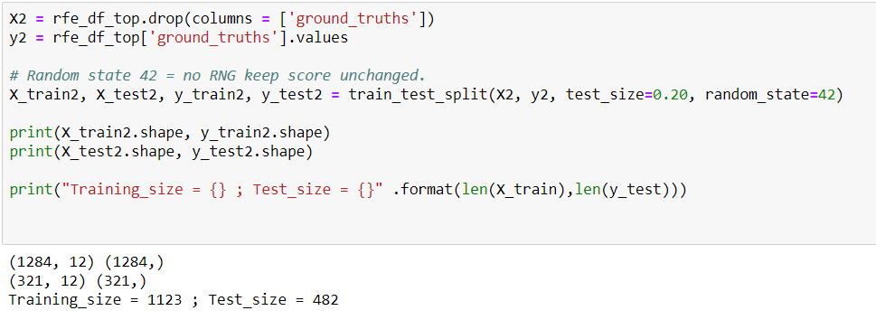
Recursive Feature Elimination (RFE)
The dataframe became a total of 1605 rows
Then we trained, tested, and splited the new dataframe with the top features with 80% train and 20% test

Slide 33
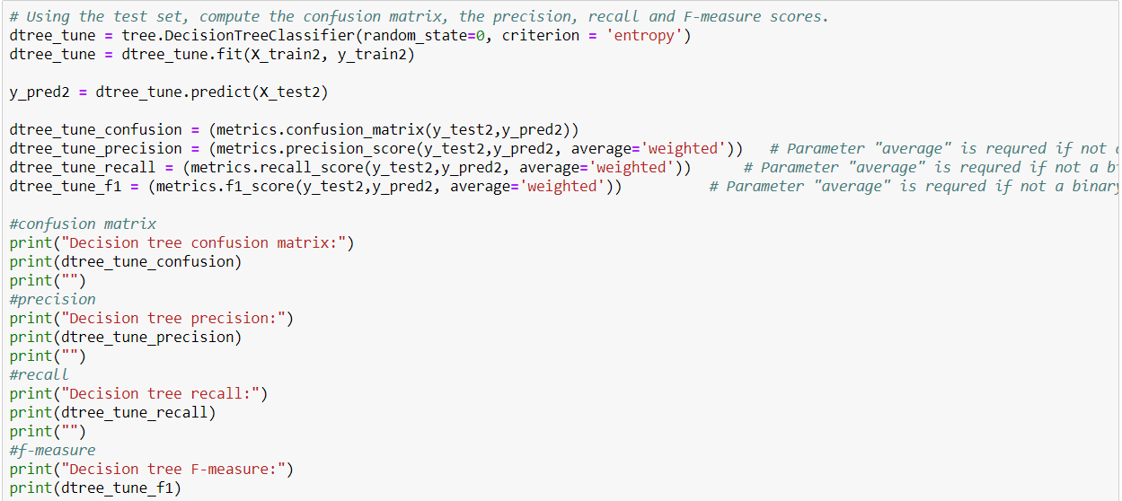
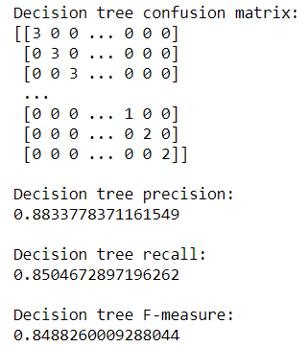
Decision Tree (Parameter Tuned)
Parameter Tuning:

Slide 34
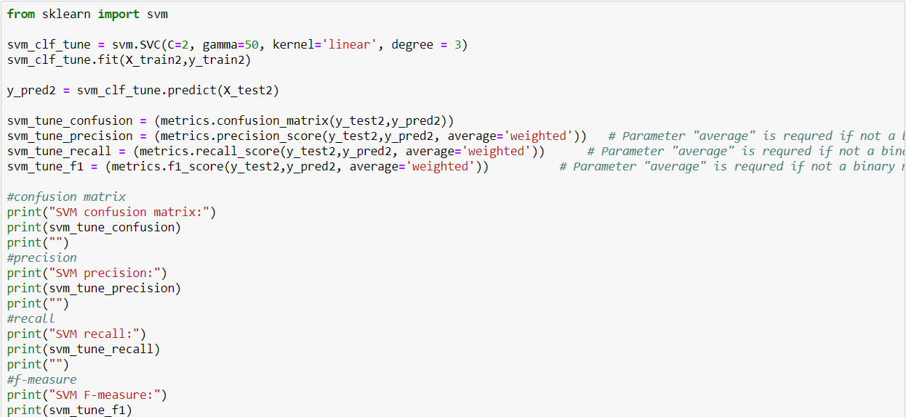
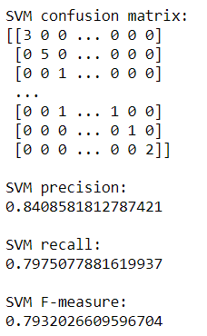
SVM (Parameter Tuned)

Slide 35
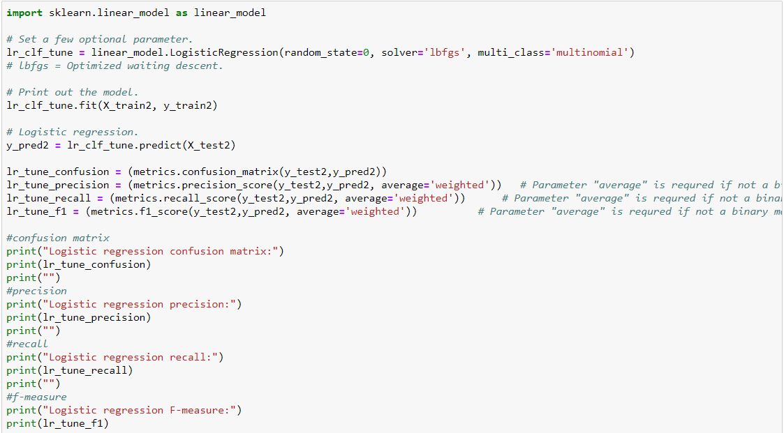
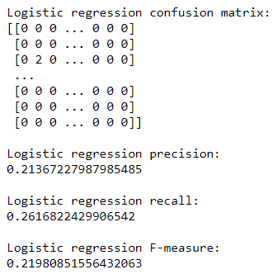
Logistic Regression (Parameter Tuned)

Slide 36
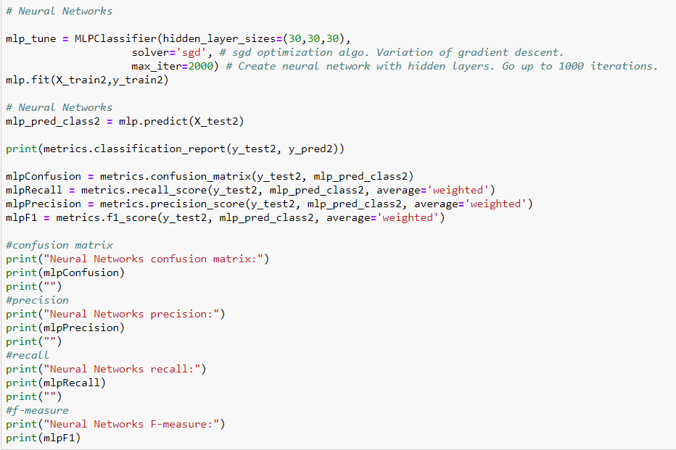
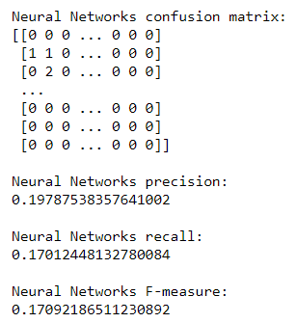
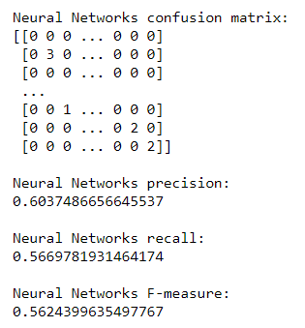
Neural Network (Parameter Tuned)

Slide 37
5.
Conclusion

Slide 38
Conclusion
Objective of project to showcase what we learned so far
Models from initial analysis was garbage
Parameter tuning and RFE improved SVM by 60%
We were able to test, train, and analyze data
Using the audio features of a song, the models performed decently well to predict the genre

Slide 39
Thanks!
Any questions?

